Slide 1
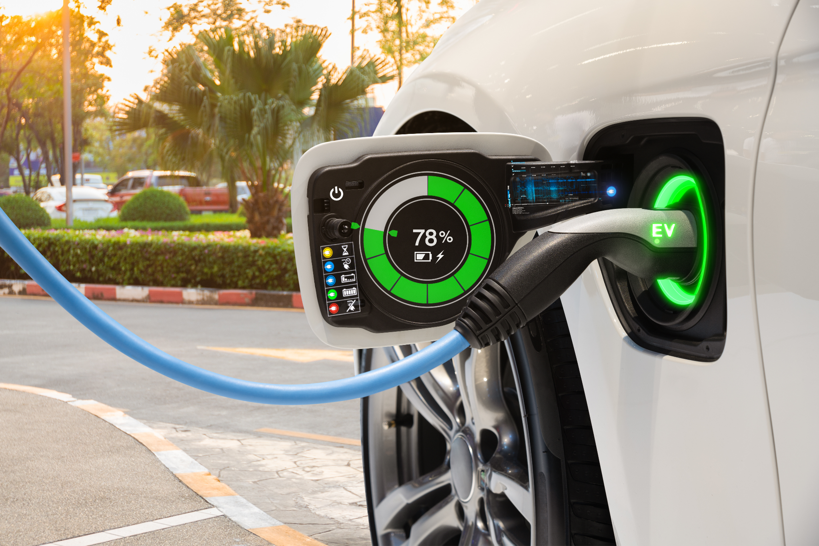
California EV Dreams
A comprehensive view of EV sales in the state of California

Slide 2
What factors contribute to sales in CA?
The purpose of this project is to analyze factors that contribute to EV purchases in the state of California. At a more granular level, we will be looking at factors within California counties to determine any relevant factors that contribute most to purchases.
With this analysis we would like to answer the following questions:
What is the opportunity in identifying a gap in this dataset?
What is the market opportunity?
Which counties in CA should EV manufacturers focus their marketing?
Should EV manufacturers be encouraging implementation of incentives to drive sales?

Slide 3
Tools & Technologies
After identifying the topic and collecting the datasets to support it, we next identified our tool set.
Establishing a clear communication tool using Slack and Google docs was of utmost importance in order to keep the flow of information going and progression forward.
Python 3.7.13 and Jupyter Notebook were used to clean, reshape and transform our data
Excel was the original format of our datasets
SQL was used to create our relational database and where we extracted our data into PG admin.
Tableau was our visual tool and what we used to create our visuals; incentives by county, sales by county and average commute of EV owners.
Google Slides we used as our primary tool for our dashboard.
HTML and CSS were both used in the building of our web application.

Slide 4
What is an EV?
An electric vehicle is a vehicle that runs fully or partially on electricity. Unlike conventional vehicles that just use fossil fuels, e-vehicles use an electric motor that is powered by a fuel cell or batteries. We can also use the terms ‘e-vehicle‘ and ‘EV.’*
* https://marketbusinessnews.com/financial-glossary/electric-vehicle/

Slide 5

Localizing trends in Global Market: What’s driving up EV sales
Global Trends
US markets Impacts
01.
EU growth (2019 – 2020) > US & everywhere else
West Coast EV uptake 2.7x more than national average
02.
Infrastructure investments ramping up in EU
Infrastructure investments & incentives to purchase EVs in planned via US Govt.
03.
Policy pressures – EU reduction in emissions and vehicles in cities
OEM strategies - model availability, production, sales targets
Policy pressures - CA, WA, CO ICE bans are coming.
04.
Corporate influence - EV company cars, values driven priorities impacting EV market
OEM: more models available, aggressive production and sales targets across
05.
06.
Consumer sentiment - price point, driving range, charging are key to adoption
Consumer sentiment - price point & driving range close to ICE
Notes:
State / By Year / Details
ICE Bans:
Washington / 2030 / All new vehicles sold must be zero emission
California / 2035 / All new vehicles sold must be zero emission
Colorado / 2050 / All new vehicles sold must be zero emission

Slide 6
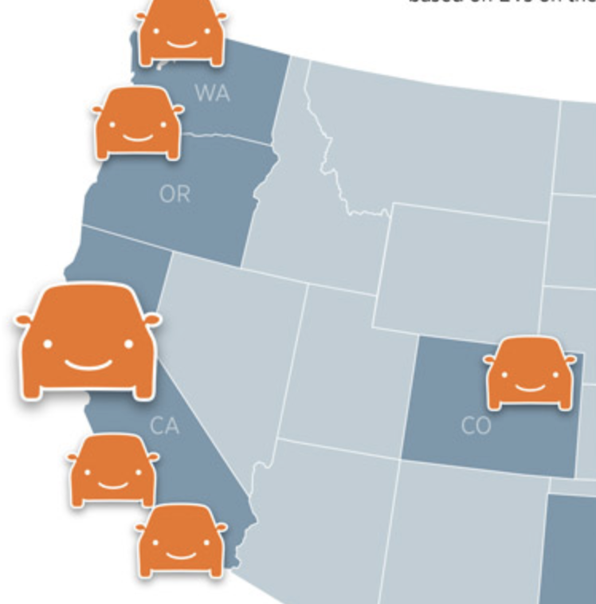
West Coast EV Adoption
Largest EV markets
West Coast EV adoption rates ~3x nat’l average
Southern California
Northern California
Seattle
Portland
EV adoption is set to grow
Many states are phasing out ICE vehicles
Investments in infrastructure and EV consumer incentives are growing
Price point and driving range are on par with ICE
*Internal Combustion Engine

Slide 7
Data Exploration
Identified topic to help guide the process of data exploration
Each of the group members took a set of data and owned that dataset.
Our data consisted of 3 datasets; demographics data for EV owners in CA, incentives by counties in CA, and sales data broken down by county, make and model.
Some counties and years were missing sales data, so we made a decision to drop the data.
One of the limitations in the data sets particularly in the incentives data was missing certain incentive start dates.
Notes:
Include data sets and type of data found in research. What was removed from our data and what was kept?
Limitations of the data: -Demographics doesn’t contain the county, which is why our main focus was on incentives and sales.
Average commute vs household income
Average age of EV drivers was 50.

Slide 8
Machine Learning Model
The initial reshaping of the data took place in Jupyter notebook. We read in each of the data sets, identified that there were several nulls that needed to be removed. In addition, we took a fraction of the data given that our demographics data set was large.
AWS Relational Database and PG Admin
After completion of the initial evaluation, cleaning and reshaping of the data, we created a relations database in AWS and connected it to our PG Admin account. This allowed us to join our datasets and start correlating our metadata.
Our Dependent variables were: Ownership/Sales
Our Independent variables were: Income, Incentives, Length of Commute, etc.
The final 3 highest correlated factors were determined by random regressor analysis.
Jupyter Notebook for our Dataset reshaping
One of the challenges we were met with is the fact that not all counties were represented in our data.
Random Regressor
In addition, we used a ranking of feature importance to identify what were the most important factors contributing to sales.
Notes:
When using random forest, we had to convert the county column with onehot encoder in order to make our data
integers.
Random forest was chosen since it provides a more accurate machine learning model from linear regression.
We switched to using random regressor while in the process of running our machine learning model since our goal was to show feature importance and not 'classify' the data.
Feature importance; In general, household income and annual miles driven by owner had little to no impact on sales.
Population
Counties like Los Angeles and Santa Clara did do the best. Los Angeles also had the most incentives by far from all other counties.

Slide 9
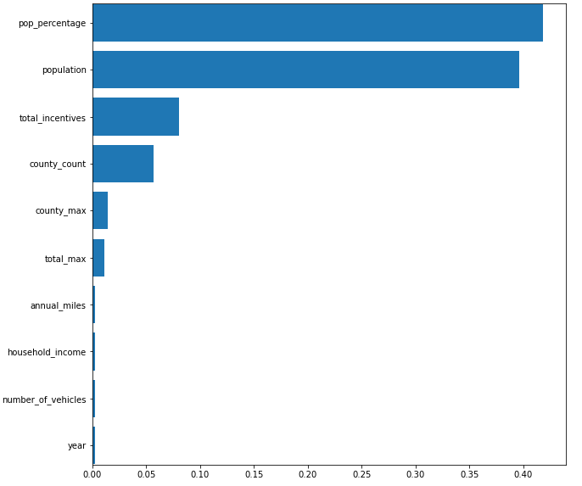
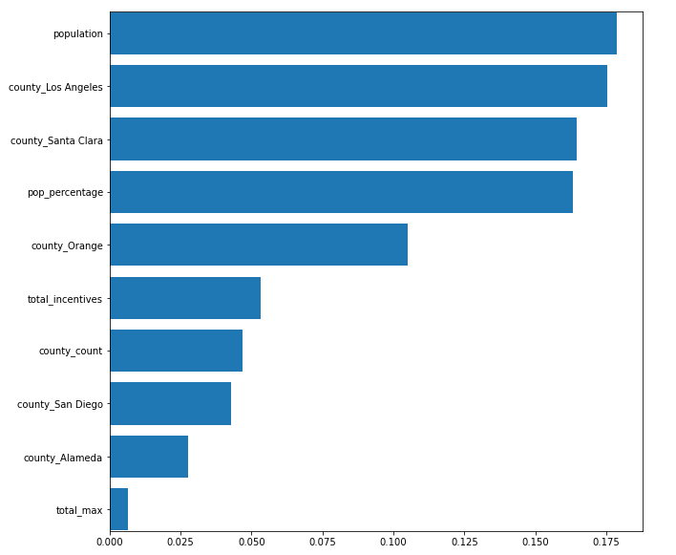
Rank of feature importance
Without County
With County
Notes:
The following two graphs represent feature importance: one graph represents the features with counties included and the other without. Based on these graphs, we can conclude that population is a major factor in number of sales of EVs followed by total number of incentives and county population.
Demographics with counties had the highest r2 and accuracy score based on the 4 data models studied.

Slide 10
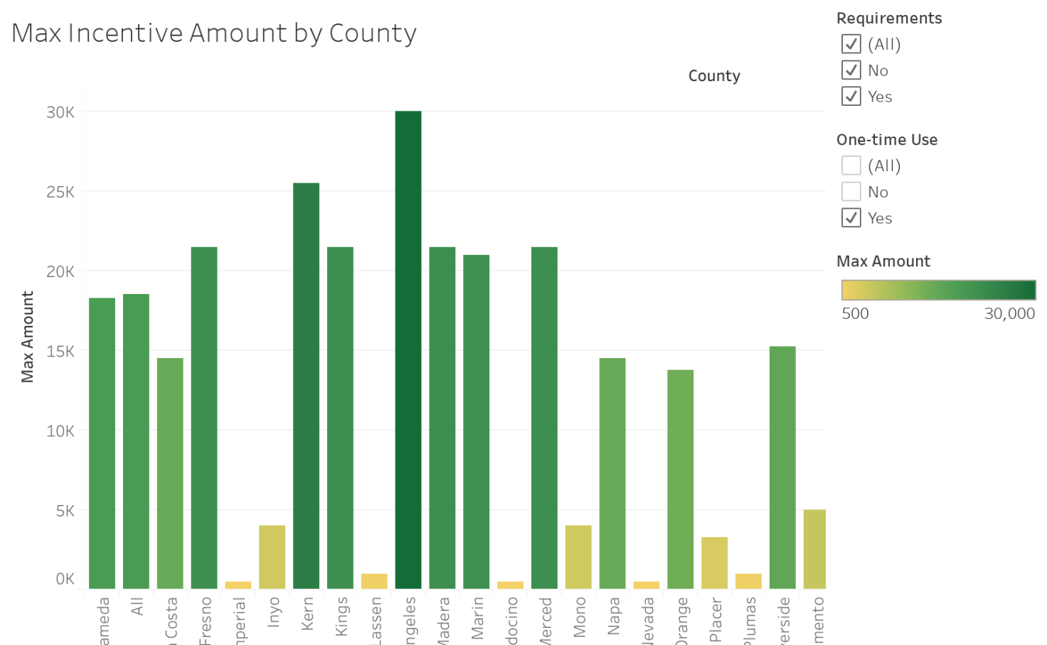
Incentives by Counties
The following bar graph illustrates the max incentives broken down by county in the state of California.
By far we can see Los Angeles county tops the chart offering up to 30K in total incentives*.
*Certain incentives require meeting several requirements in order to be eligible.

Slide 11
Conclusions
What did we learn?
Population is one of the biggest factors contributing to EV sales as is evident by the data.
The more incentives offered by the county, the higher EV sales tend to be.
Demographics in general did not have a high impact on sales.
The average age of an EV owner was 50.
Notes:
Answers to questions
Potential opps
What else?
Future investigations; given more time what would we have done more of?

Slide 12
Future Opportunities
Potential limitations of our data; our database for demographics did not contain county thus limited shared data with other databases.
Potential opportunities for manufacturers of EV vehicles could be as simple as awareness of incentives to counties with a lower EV purchase rate particularly in smaller populated counties.
Does ethnic/racial diversity matter and/or contribute to EV sales?
What about age? Should manufactures target market a younger demographic group by building a customer centric approach to their marketing?
How much money does a typical EV owner save in fuel cost? And how much does this matter?
What type of EV has higher sales and what are the factors that contribute to a higher sales margin?

